Slide 1


GLAUCOMA AWARENESS
THE WORLD GLAUCOMA ASSOCIATION

Slide 2
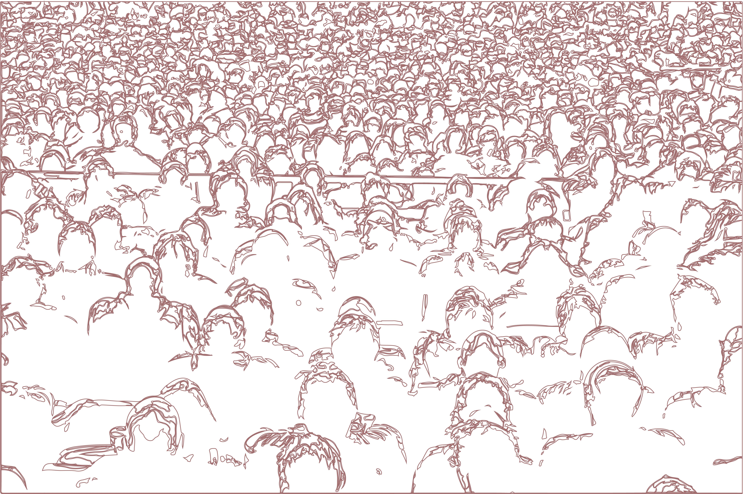
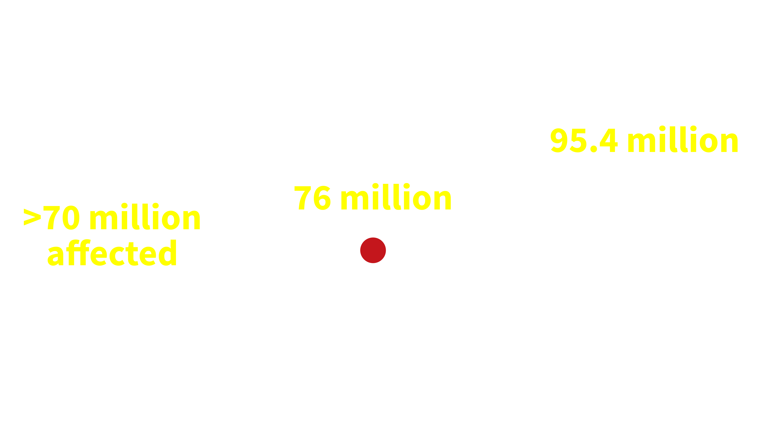






Glaucoma is the #2 cause of preventable irreversible blindness.
7.7
million
people have
moderate or severe distance
vision impairment or blindness from glaucoma
No. of people estimated to have glaucoma is expected to increase
Vision Loss Expert Group of the Global Burden of Disease Study. Lancet Global Health 2020.

Slide 3
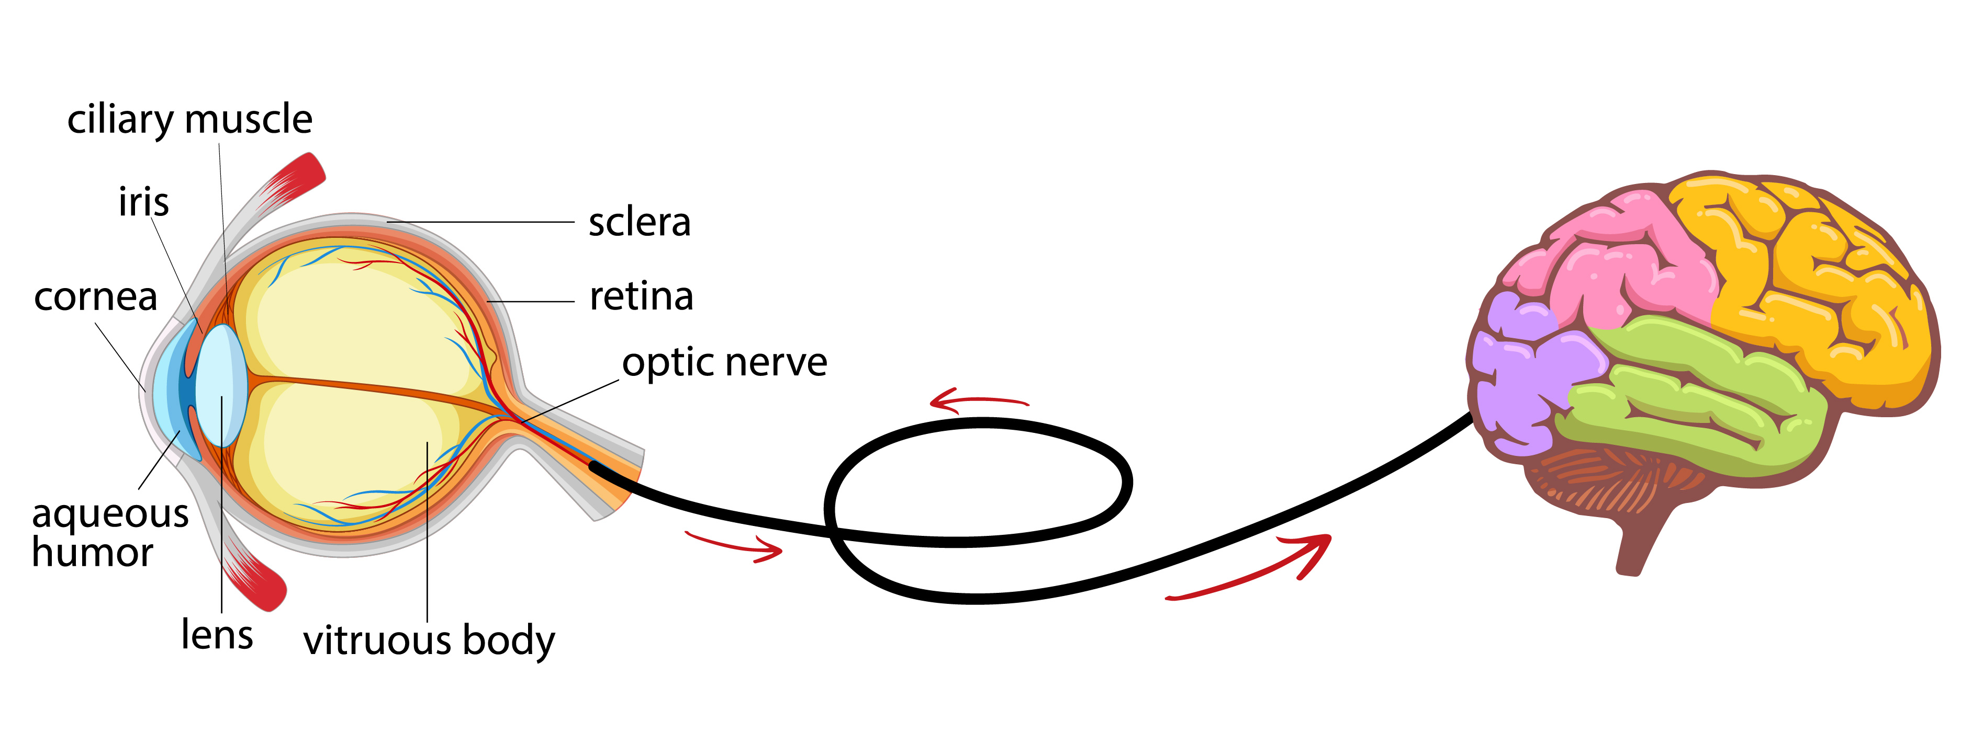
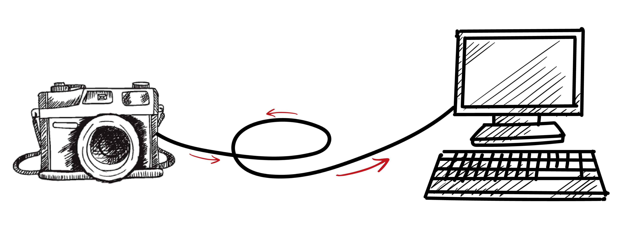
What is Glaucoma anyway?
The optic nerve comprises of millions of nerve fibers that carry signals of what we see.
It runs from the eye to the brain.
… similar to how the information from a camera is transmitted to a monitor screen!

Slide 4
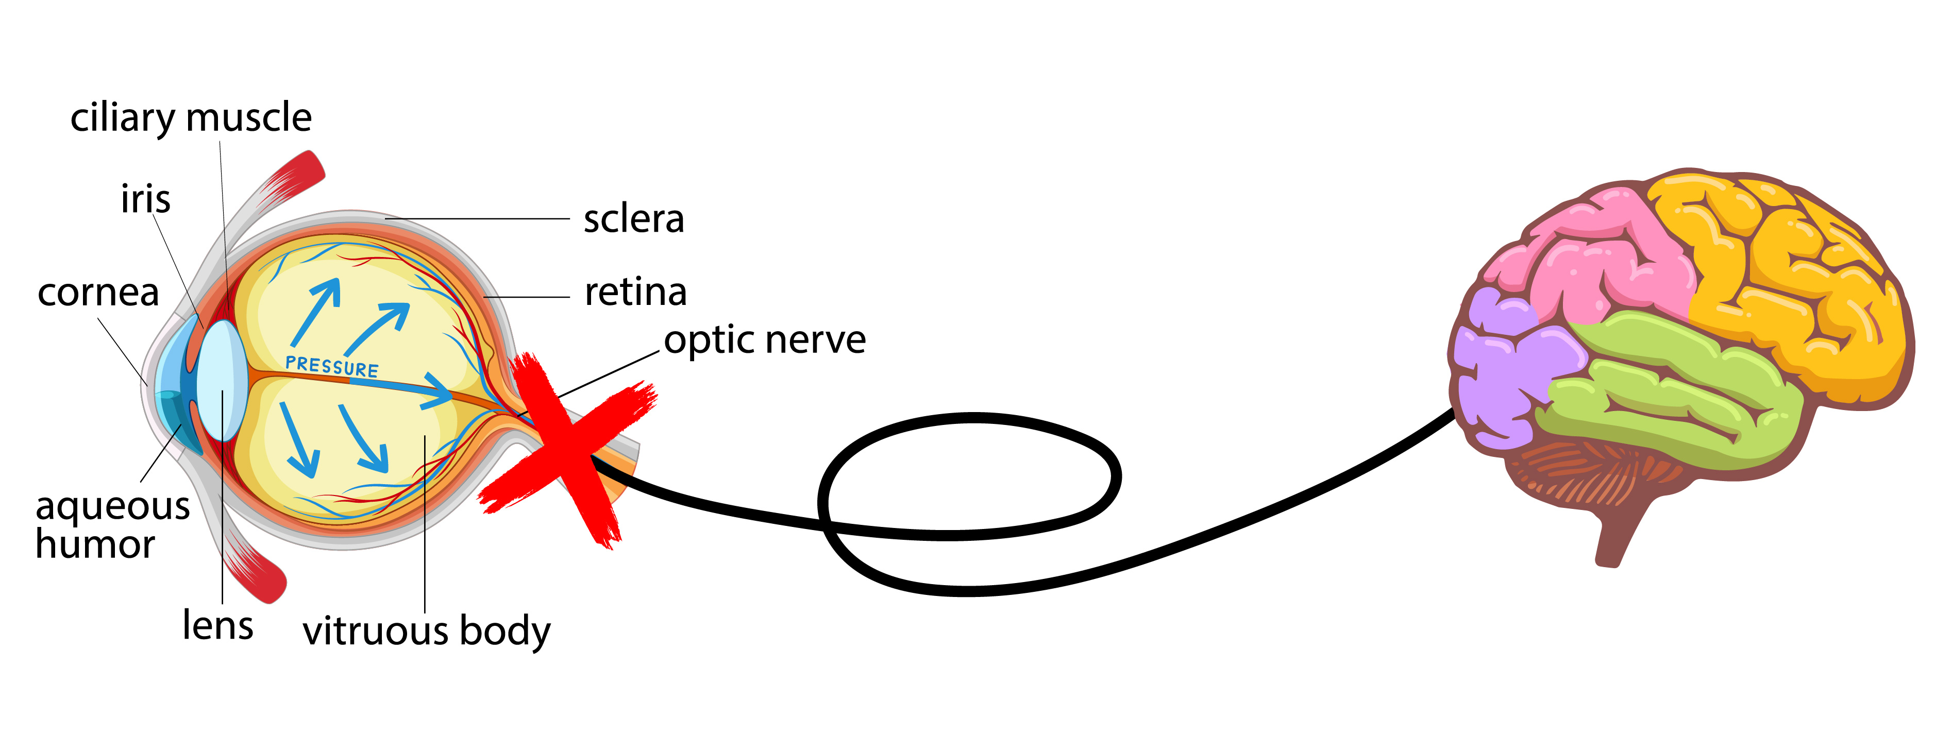

What is Glaucoma anyway?
In glaucoma, the nerve fibers in the optic nerve are progressively damaged.
… Like a wire that becomes progressively frayed
and thinner.

Slide 5
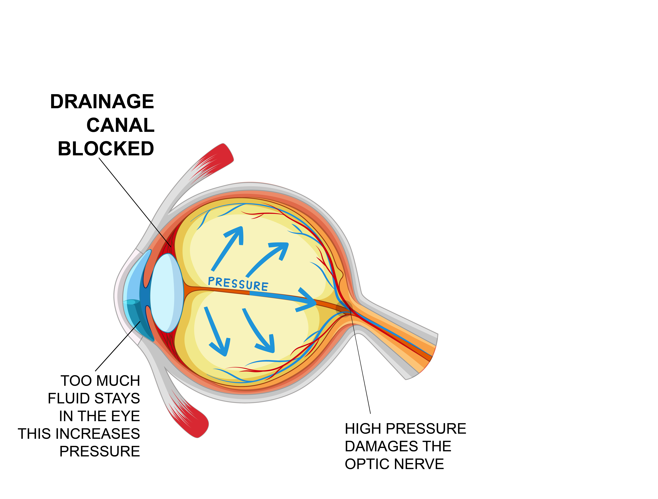

Glaucoma treatment
aims to reduce the risk of further optic nerve damage by reducing
the eye pressure

Slide 6
“Need more light to see…”
“Letters
appear faded when
reading”
How does Glaucoma affect individuals’ lives?
“Difficulty seeing objects at the sides”
“Some areas are darker or missing”
Hu CX, et al. Am J Med Sci. 2014; 348(5): 403–409.
“Vision is blurry”

Slide 7




How does glaucoma affect these individuals’ lives?
As the glaucoma progresses, it can impact:
Driving, walking, venturing from home, reading
Seeing at night, adjusting to different levels of illumination, judging distances
Seeing peripheral objects, and moving objects coming from the side
Motor vehicle accidents and injuries related to falls are potentially serious consequences
They may not be able to …
They may be at risk of…
Falls
Mental
Health
issues
Drive
safely
Work/ do certain jobs
Perceive colors normally
Ramulu PY, et al. Ophthalmology. 2012; 119(6): 1159-1166.
Goldberg I, et al. J Glaucoma. 2009; 18(1): 6-12.
Haymes SA, et al. Invest Ophthalmol Vis Sci. 2007; 48(3): 1149-1155.

Slide 8
Falls, injuries and
poorer quality of life
“A greater likelihood of bumping into
objects while walking”
“Visual field loss from glaucoma is
associated with a higher risk of falling”
Lower quality of life from the fear of falls
and decreased independence
Haymes SA, et al. Invest Ophthalmol Vis Sci. 2007; 48(3): 1149-1155.
Lamoureux EL, et al. Invest Ophthalmol Vis Sci. 2008; 49(2): 528-533.
Freeman EE, et al. Ophthalmology. 2008; 115(2):233-238.
McKean-Cowdin R, et al. Ophthalmology. 2008; 115(6): 941-948.e1.
Friedman DS, et al. Ophthalmology. 2007; 114(12): 2232-2237.

Slide 9
Mental health
burden of glaucoma
13.0–30% prevalence of anxiety in glaucoma patients
10.9-24.7% prevalence of depression in glaucoma patients
Most qualitative studies have reported that
glaucoma patients interpret their disease
as contributing to anxiety and/or depression
Moussavi, S. et al. Lancet. 2007; 370(9590): 851-858.
Zhang, X. et al. Am J Ophthalmol. 2017; 183: 37-41.
Wilson MR, et al. Ophthalmology. 2002; 109(5): 1018-1022.
Wang SY, et al. Am J Ophthalmol. 2012; 154(3): 436-444.e432.
Rezapour J, et al. BMC Ophthalmol. 2018; 18(1): 157.

Slide 10
If glaucoma affects one’s vision so much,
why are people not started on treatment earlier?
Many remain undiagnosed
How many?
Who can get glaucoma?
> 1/3 of glaucoma cases remain undiagnosed.
Estimated 3% of the global population over 40 years of age currently has glaucoma, the majority of whom are undiagnosed.
Anyone!
Of any age (even children),
race or nationality
Whitson, JT. Expert Opin. Pharmacother. 2007; 8(18): 3237-3249.
Varma R, et al. Am J Ophthalmol. 2014; 152(4): 515-522.

Slide 11
Most people are not aware that they have problems with their vision and do not notice any vision loss.
Why are people
not diagnosed with
glaucoma earlier?
Early visual field defects mean that 40% of the nerve fibers are already irreversibly damaged!
Glaucoma has
no symptoms in
the early stages!
Quigley, HA. Lancet. 2011; 377(9774): 1367-1377.
Sommer, et al. Arch. Ophthalmol. 1991; 109(1): 77-83.

Slide 12
Glaucoma is a chronic disease
It can be treated but not cured or reversed,
early diagnosis is key!
There is no cure for glaucoma,
but proper treatment can slow or prevent sight loss.

Slide 13

Glaucoma diagnosis as early as possible
is key to prevent vision problems
GET TESTED!
“Doctor,
I realized I cannot see.
What can I do to
regain my vision?”
“Unfortunately, your vision cannot be improved. We will start you on treatment to preserve your remaining vision.”
This is why glaucoma
is known as the
‘silent thief of sight’

Slide 14
Fortunately, blindness is preventable
if glaucoma is detected and treated earlier

Slide 15
Getting tested is important!
Talk to your family members!
First-degree relatives with glaucoma may have 4-8x higher risk.
Visit your ophthalmologist!
Your ophthalmologist will guide you to the best treatment option in each individual case!

Slide 16
Proper treatment can prevent or slow vision loss due to glaucoma
All forms of glaucoma
can be treated
Treatment options include daily eyedrops, laser, or eye surgery.
Glaucoma diagnosis usually causes stress and concern
Quigley, HA. Lancet. 2011; 377(9774): 1367-1377.
Sommer, et al. Arch. Ophthalmol. 1991; 109(1): 77-83.

Slide 17
Glaucoma Treatment with Eyedrops:
Regularity and Persistence
1.
Similarly to Diabetes and High Blood Pressure, glaucoma needs continuous daily use of medication(s)
2.
Glaucoma eyedrops may cause discomfort – talk to your Ophthalmologist – he can help you feel better!
3.
Maintain your treatment: even when there is no symptoms or visual loss
early glaucoma
4.
MAINTAIN YOUR TREATMENT: even when there is no improvement in vision
advanced glaucoma – don’t let it get worse!

Slide 18
Corticoids may cause glaucoma!
1.
Corticoids are good and effective medications for many health problems
CAUTION HERE
2.
However, inappropriate use of corticoids may cause glaucoma and permanent vision loss
3.
Take extra care with eyedrops with corticoids: the more you use, the higher the risks
IMPORTANT ADVICE
4.
Only use corticoids when prescribed by your doctor, he will know how to use corticoids safely

Slide 19
What can be done to relieve the
global burden imposed by glaucoma?
1.
Optimize detection / screening protocols. GET TESTED!!
2.
Implementation of cost-effective screening programs or improve education to optimize opportunistic case-detection
Prevent / reduce vision loss from glaucoma
3.
Optimise glaucoma treatment options (medications, laser, surgery)
Minimise / stop glaucoma progression
4.
Research: develop new therapeutics to prevent, treat, and perhaps even recover glaucoma damage
Reverse the ‘irreversible’ vision loss from glaucoma

Slide 20
Glaucoma has an impact on
the rest of society! ROAD SAFETY!
Drivers with mild-to-moderate visual field loss from
glaucoma (compared with age-matched controls)
Impaired driving performance
Less safe
Significantly more problems with observation,
maintaining lane position and approach and planning
“…made significantly more errors at traffic light-controlled
and give-way (yield) intersections.”
“Importantly,
the consequences of errors in these traffic situations are likely to involve multiple road users (vehicles and pedestrians) and have significant safety consequences.”
Wood JM, et al. PLoS One. 2016; 11(7): e0158318.

Slide 21
Acknowledgements – Images
https://www.aao.org/eye-health/diseases/glaucoma-vision-simulator
https://www.google.com/url?sa=i&url=https%3A%2F%2Fwww.vectorstock.com%2Froyalty-free-vector%2Fblind-man-stick-figure-walking-with-a-white-cane-vector-31902257&psig=AOvVaw2b0pWQAZROczCMNCnwF42h&ust=1620056683897000&source=images&cd=vfe&ved=0CAIQjRxqFwoTCLDjytCrq_ACFQAAAAAdAAAAABAE
https://www.google.com/url?sa=i&url=https%3A%2F%2Fwww.glaucoma.org%2Fglaucoma%2Fanatomy-of-the-eye.php&psig=AOvVaw0QsKfdYj2A4-_2mybJfZ6Z&ust=1620056840839000&source=images&cd=vfe&ved=0CAIQjRxqFwoTCMjskJmsq_ACFQAAAAAdAAAAABAJ
https://www.google.com/url?sa=i&url=https%3A%2F%2Fen.wikipedia.org%2Fwiki%2FOccipital_lobe&psig=AOvVaw0RgZwxZwWgF6iYDDOrUO2L&ust=1620057392410000&source=images&cd=vfe&ved=0CAIQjRxqFwoTCNDtwKOuq_ACFQAAAAAdAAAAABAE
https://www.google.com/url?sa=i&url=https%3A%2F%2Fwww.nicepng.com%2Fourpic%2Fu2q8y3a9u2o0u2y3_camera-drawing-png-camera-drawing%2F&psig=AOvVaw0x3JQJLzaupFfPDNUqJjd7&ust=1620056975062000&source=images&cd=vfe&ved=0CAIQjRxqFwoTCLCI69qsq_ACFQAAAAAdAAAAABAX
https://www.google.com/url?sa=i&url=http%3A%2F%2Fgetdrawings.com%2Fcomputer-screen-drawing&psig=AOvVaw1LzzA2rfGWSvGSdmwx_Ff_&ust=1620057306000000&source=images&cd=vfe&ved=0CAIQjRxqFwoTCPim5_ytq_ACFQAAAAAdAAAAABAD
https://tiel1600.wordpress.com/2018/01/02/glaucoma-increased-eye-pressure/
https://www.google.com/url?sa=i&url=https%3A%2F%2Fwww.shutterstock.com%2Fimage-vector%2Fwarning-steep-downhill-sign-vector-1882274386&psig=AOvVaw1KO0H0UDjKxAcJIZyNpwKY&ust=1620058990479000&source=images&cd=vfe&ved=0CAIQjRxqFwoTCIjqpZ20q_ACFQAAAAAdAAAAABAK
https://cdn.who.int/media/docs/default-source/infographics-pdf/world-vision-infographic-final.pdf?sfvrsn=85b7bcde_2
Whitney, D., & Levi, D. M. (2011). Visual crowding: a fundamental limit on conscious perception and object recognition. Trends in Cognitive Sciences, 15(4), 160–168. https://doi.org/10.1016/j.tics.2011.02.005
https://www.google.com/url?sa=i&url=http%3A%2F%2Fclipart-library.com%2Fclipart%2F1476043.htm&psig=AOvVaw3rAzIpp_bCy7aV9frKsyxW&ust=1620627054729000&source=images&cd=vfe&ved=0CAIQjRxqFwoTCLjr1bT4u_ACFQAAAAAdAAAAABAD
https://www.google.com/url?sa=i&url=https%3A%2F%2Fstock.adobe.com%2Fsearch%3Fk%3Drobber%2520cartoon&psig=AOvVaw2a9q90aHFvz4sfnHclBI7D&ust=1621230357145000&source=images&cd=vfe&ved=0CAIQjRxqFwoTCPDT-Py_zfACFQAAAAAdAAAAABAE
https://www.google.com/url?sa=i&url=https%3A%2F%2Fwww.illustrationsof.com%2F433588-royalty-free-blind-clipart-illustration&psig=AOvVaw1jIgcYAsdQHNTwzWUKhWaq&ust=1621230606411000&source=images&cd=vfe&ved=0CAIQjRxqFwoTCKDXgefAzfACFQAAAAAdAAAAABAK
https://www.google.com/url?sa=i&url=https%3A%2F%2Fwww.easylinedrawing.com%2Fhow-to-draw-a-cartoon-car-step-by-step%2F&psig=AOvVaw2nNjEi91qLE0ONlkiNSJge&ust=1620627782693000&source=images&cd=vfe&ved=0CAIQjRxqFwoTCOC155f7
https://www.google.com/url?sa=i&url=https%3A%2F%2Fwww.dreamstime.com%2Fillustration%2Fstop-security-cartoon.html&psig=AOvVaw2m8iR6tqDUfZljcHkaLYNk&ust=1621237532352000&source=images&cd=vfe&ved=0CAIQjRxqFwoTCLCi5MzazfACFQAAAAAdAAAAABAJ
https://www.google.com/imgres?imgurl=https%3A%2F%2Fwww.pngfind.com%2Fpngs%2Fm%2F178-1788173_clipart-desktop-computer-animation-desktop-computer-hd-png.png&imgrefurl=https%3A%2F%2Fwww.pngfind.com%2Fmpng%2FmhhTom_clipart-desktop-computer-animation-desktop-computer-hd-png%2F&tbnid=0qYkK4Fq_pGIdM&vet=12ahUKEwjg85fw-7vwAhWKPCsKHR6bBQ8QMyg3egQIARBi..i&docid=367m5WIUiR7TQM&w=840&h=640&q=computer%20animation&hl=en&ved=2ahUKEwjg85fw-7vwAhWKPCsKHR6bBQ8QMyg3egQIARBiu_ACFQAAAAAdAAAAABAE
https://st2.depositphotos.com/4356917/6429/v/600/depositphotos_64292935-stock-illustration-flowers-with-happy-smiling-faces.jpg
https://cdn4.iconfinder.com/data/icons/old-man-elderly-injured-injury-pain/197/old-man-pain-10-512.png
https://banner2.cleanpng.com/20180508/bdw/kisspng-sadness-stock-photography-depression-royalty-free-5af1263fa7fa03.2488389315257534076881.jpg
https://www.pngitem.com/pimgs/m/7-78539_clip-art-cartoon-cars-crashing-car-accident-clipart.png
http://st2.depositphotos.com/1504872/8305/v/450/depositphotos_83058918-Cartoon-ambulance-car-isolated.jpg
https://www.glaucoma.org/uploads/optic-nerve-comparison_290.jpg

