Slide 1


How Glaucoma may affect your vision?
THE WORLD GLAUCOMA ASSOCIATION

Slide 2

How Glaucoma may affect your vision?
- Part I -

Slide 3

What if all you could see was…
…this?

Slide 4

When you should be
seeing this?

Slide 5

How Glaucoma affects your vision?
Dark areas are commonly used to describe vision loss due to glaucoma…

Slide 6
But most glaucoma patients describe a blurred vision or missing parts

Slide 7
How Glaucoma may affect your vision?
- Part II -

Slide 8
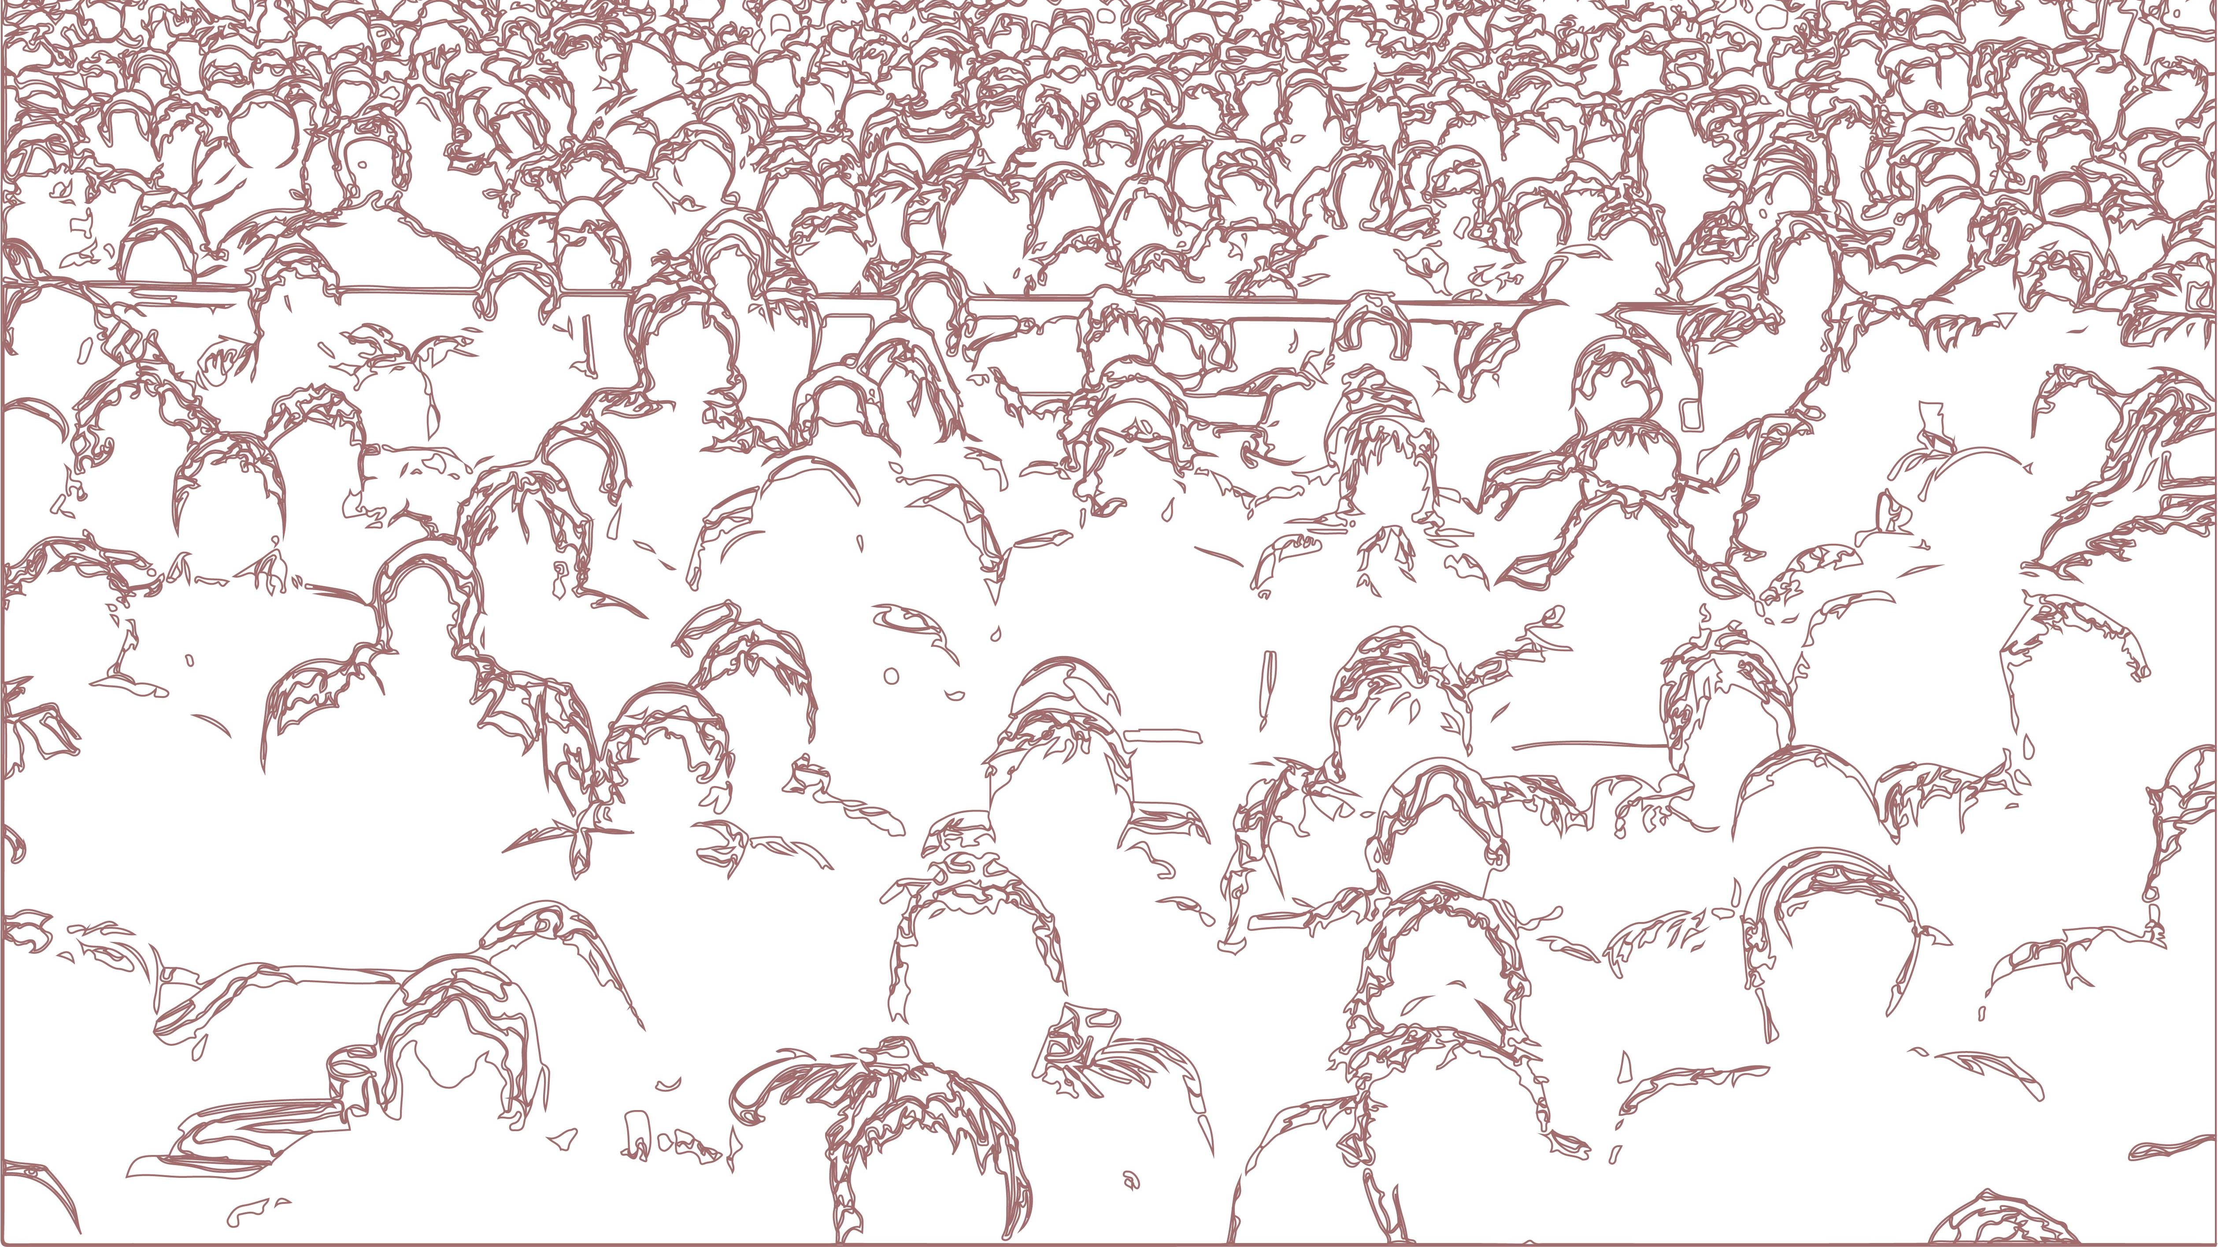
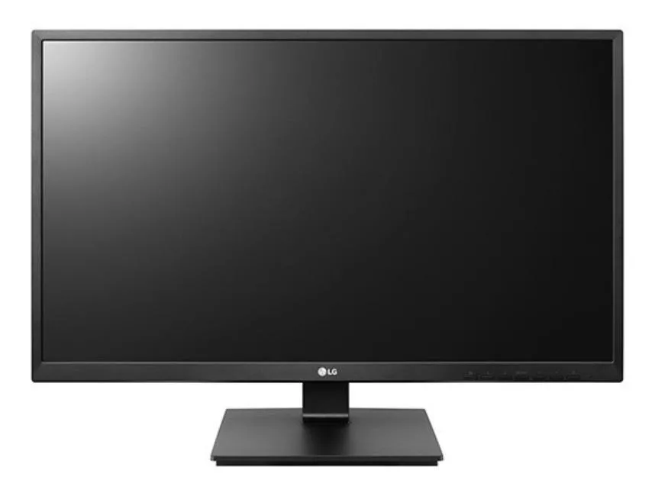
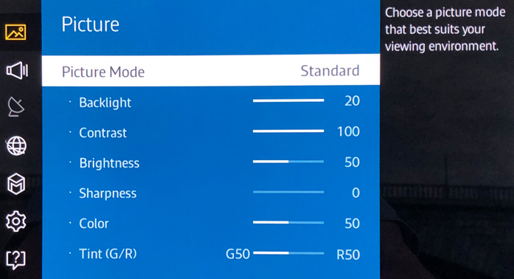
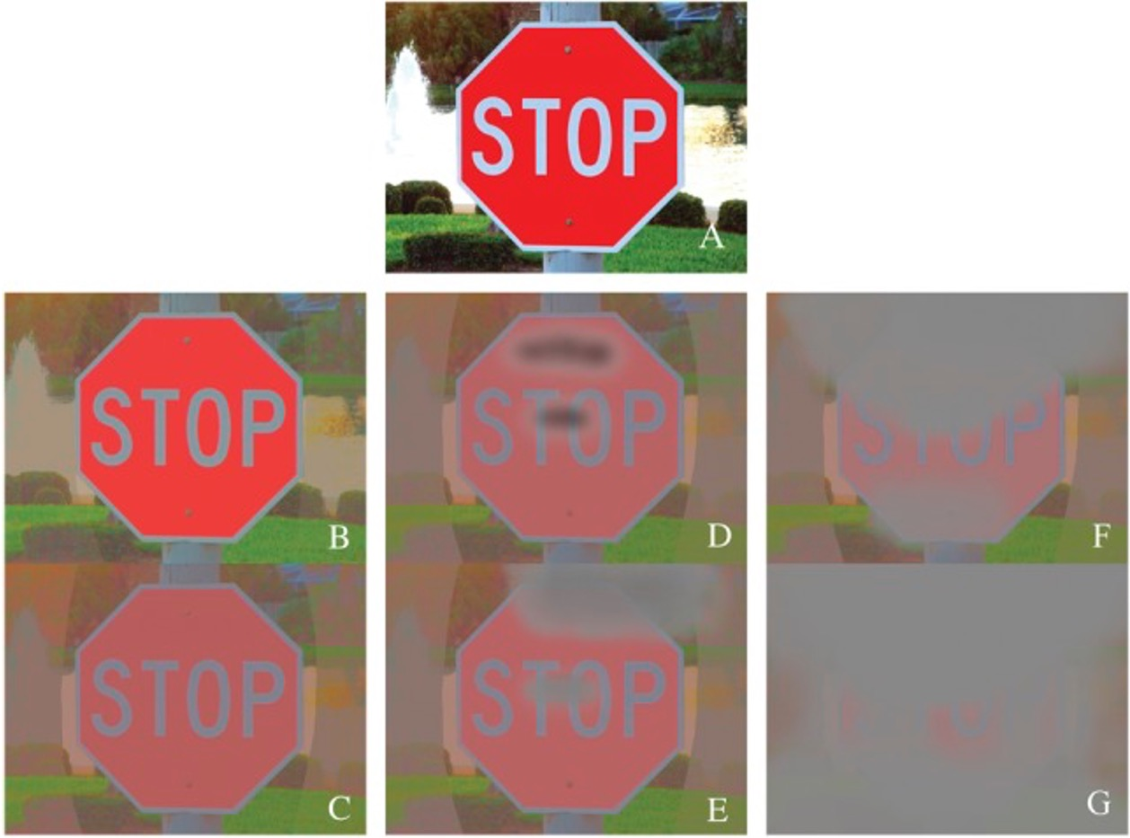

Contrast and Glaucoma?
Progressive loss
of contrast
sensitivity
in advanced
Glaucoma
NORMAL VISION
AREAS THAT CANNOT BE SEEN
Hu CX, et al. Am J Med Sci. 2014; 348(5): 403–409.

Slide 9
How Glaucoma may affect your vision?
- Part III -

Slide 10
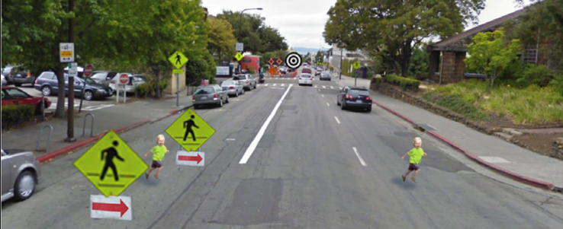
Please look straight to the bulls eye – at the blue arrow
Whitney D, Levi DM. Trends Cogn Sci. 2011 Apr;15(4):160-8.

Slide 11
While still looking at the bulls eye, can you see the child on the right side of your screen?
Whitney D, Levi DM. Trends Cogn Sci. 2011 Apr;15(4):160-8.

Slide 12
While still looking at the bulls eye, can you see the child on the left side?
Whitney D, Levi DM. Trends Cogn Sci. 2011 Apr;15(4):160-8.

Slide 13
It is more difficult to note the child on the left due to a phenomenon called visual crowding – which may be more pronounced in glaucoma patients.
Whitney D, Levi DM. Trends Cogn Sci. 2011 Apr;15(4):160-8.

Slide 14
Acknowledgements – Images
https://www.aao.org/eye-health/diseases/glaucoma-vision-simulator
https://www.google.com/url?sa=i&url=https%3A%2F%2Fwww.vectorstock.com%2Froyalty-free-vector%2Fblind-man-stick-figure-walking-with-a-white-cane-vector-31902257&psig=AOvVaw2b0pWQAZROczCMNCnwF42h&ust=1620056683897000&source=images&cd=vfe&ved=0CAIQjRxqFwoTCLDjytCrq_ACFQAAAAAdAAAAABAE
https://www.google.com/url?sa=i&url=https%3A%2F%2Fwww.glaucoma.org%2Fglaucoma%2Fanatomy-of-the-eye.php&psig=AOvVaw0QsKfdYj2A4-_2mybJfZ6Z&ust=1620056840839000&source=images&cd=vfe&ved=0CAIQjRxqFwoTCMjskJmsq_ACFQAAAAAdAAAAABAJ
https://www.google.com/url?sa=i&url=https%3A%2F%2Fen.wikipedia.org%2Fwiki%2FOccipital_lobe&psig=AOvVaw0RgZwxZwWgF6iYDDOrUO2L&ust=1620057392410000&source=images&cd=vfe&ved=0CAIQjRxqFwoTCNDtwKOuq_ACFQAAAAAdAAAAABAE
https://www.google.com/url?sa=i&url=https%3A%2F%2Fwww.nicepng.com%2Fourpic%2Fu2q8y3a9u2o0u2y3_camera-drawing-png-camera-drawing%2F&psig=AOvVaw0x3JQJLzaupFfPDNUqJjd7&ust=1620056975062000&source=images&cd=vfe&ved=0CAIQjRxqFwoTCLCI69qsq_ACFQAAAAAdAAAAABAX
https://www.google.com/url?sa=i&url=http%3A%2F%2Fgetdrawings.com%2Fcomputer-screen-drawing&psig=AOvVaw1LzzA2rfGWSvGSdmwx_Ff_&ust=1620057306000000&source=images&cd=vfe&ved=0CAIQjRxqFwoTCPim5_ytq_ACFQAAAAAdAAAAABAD
https://tiel1600.wordpress.com/2018/01/02/glaucoma-increased-eye-pressure/
https://www.google.com/url?sa=i&url=https%3A%2F%2Fwww.shutterstock.com%2Fimage-vector%2Fwarning-steep-downhill-sign-vector-1882274386&psig=AOvVaw1KO0H0UDjKxAcJIZyNpwKY&ust=1620058990479000&source=images&cd=vfe&ved=0CAIQjRxqFwoTCIjqpZ20q_ACFQAAAAAdAAAAABAK
https://cdn.who.int/media/docs/default-source/infographics-pdf/world-vision-infographic-final.pdf?sfvrsn=85b7bcde_2
Whitney, D., & Levi, D. M. (2011). Visual crowding: a fundamental limit on conscious perception and object recognition. Trends in Cognitive Sciences, 15(4), 160–168. https://doi.org/10.1016/j.tics.2011.02.005
https://www.google.com/url?sa=i&url=http%3A%2F%2Fclipart-library.com%2Fclipart%2F1476043.htm&psig=AOvVaw3rAzIpp_bCy7aV9frKsyxW&ust=1620627054729000&source=images&cd=vfe&ved=0CAIQjRxqFwoTCLjr1bT4u_ACFQAAAAAdAAAAABAD
https://www.google.com/url?sa=i&url=https%3A%2F%2Fstock.adobe.com%2Fsearch%3Fk%3Drobber%2520cartoon&psig=AOvVaw2a9q90aHFvz4sfnHclBI7D&ust=1621230357145000&source=images&cd=vfe&ved=0CAIQjRxqFwoTCPDT-Py_zfACFQAAAAAdAAAAABAE
https://www.google.com/url?sa=i&url=https%3A%2F%2Fwww.illustrationsof.com%2F433588-royalty-free-blind-clipart-illustration&psig=AOvVaw1jIgcYAsdQHNTwzWUKhWaq&ust=1621230606411000&source=images&cd=vfe&ved=0CAIQjRxqFwoTCKDXgefAzfACFQAAAAAdAAAAABAK
https://www.google.com/url?sa=i&url=https%3A%2F%2Fwww.easylinedrawing.com%2Fhow-to-draw-a-cartoon-car-step-by-step%2F&psig=AOvVaw2nNjEi91qLE0ONlkiNSJge&ust=1620627782693000&source=images&cd=vfe&ved=0CAIQjRxqFwoTCOC155f7
https://www.google.com/url?sa=i&url=https%3A%2F%2Fwww.dreamstime.com%2Fillustration%2Fstop-security-cartoon.html&psig=AOvVaw2m8iR6tqDUfZljcHkaLYNk&ust=1621237532352000&source=images&cd=vfe&ved=0CAIQjRxqFwoTCLCi5MzazfACFQAAAAAdAAAAABAJ
https://www.google.com/imgres?imgurl=https%3A%2F%2Fwww.pngfind.com%2Fpngs%2Fm%2F178-1788173_clipart-desktop-computer-animation-desktop-computer-hd-png.png&imgrefurl=https%3A%2F%2Fwww.pngfind.com%2Fmpng%2FmhhTom_clipart-desktop-computer-animation-desktop-computer-hd-png%2F&tbnid=0qYkK4Fq_pGIdM&vet=12ahUKEwjg85fw-7vwAhWKPCsKHR6bBQ8QMyg3egQIARBi..i&docid=367m5WIUiR7TQM&w=840&h=640&q=computer%20animation&hl=en&ved=2ahUKEwjg85fw-7vwAhWKPCsKHR6bBQ8QMyg3egQIARBiu_ACFQAAAAAdAAAAABAE
https://st2.depositphotos.com/4356917/6429/v/600/depositphotos_64292935-stock-illustration-flowers-with-happy-smiling-faces.jpg
https://cdn4.iconfinder.com/data/icons/old-man-elderly-injured-injury-pain/197/old-man-pain-10-512.png
https://banner2.cleanpng.com/20180508/bdw/kisspng-sadness-stock-photography-depression-royalty-free-5af1263fa7fa03.2488389315257534076881.jpg
https://www.pngitem.com/pimgs/m/7-78539_clip-art-cartoon-cars-crashing-car-accident-clipart.png
http://st2.depositphotos.com/1504872/8305/v/450/depositphotos_83058918-Cartoon-ambulance-car-isolated.jpg
https://www.glaucoma.org/uploads/optic-nerve-comparison_290.jpg

